Slide 1


Blinkx
BlinkX BrainAThon: NotifiMaster Challenge
Building a
personalised and data driven
push notification system
Team Members:
Abhishek L
Mahi Mittal
Gaurav Tripathi

Slide 2
PUSH NOTIFICATION?
Why are Push Notifications Needed?
A push notification is a brief message that pops up on a user's device, such as a mobile phone or desktop computer, or appears in the notification center.
These notifications serve various purposes, including marketing, customer support, and security alerts.
There are two main types of push notifications: Web Push Notification
01
Improved User Engagement
Push notifications can increase user engagement by keeping users informed about updates, offers, and events.
02
Enhanced Customer Retention
Push notifications can help retain customers by sending personalized and timely messages.
03
Increased Conversion Rates
Push notifications can boost conversion rates by sending targeted and relevant messages.
03
Better Customer Insights
Push notifications can provide valuable insights into user behavior and preferences.

Slide 3





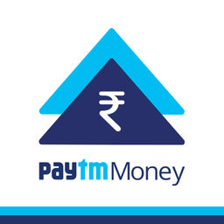
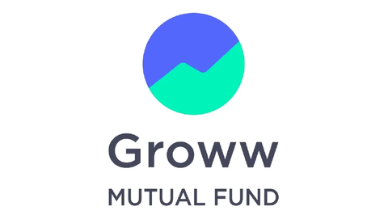
ABOUT BLINKX
Target user segment:
BlinkX is a digital broking app developed by JM Financial, aiming to revolutionize the Indian broking industry with its cutting-edge technology and customer-centric.Financial inclusion for 250 million Indians by 2027 through innovative financial products. Its key features are:
Client-Centric Approach: Ensures personalised service.
Holistic Financial Solutions: Gives easy-to-use money planning tools for every financial journey.
Data-Driven Insights: Provides real-time market updates and investment guidance based on data.
User-Friendly Interface: Easy-to-use platform for managing investments and accessing financial information.
New and Young Investors
Tech-Savvy Users
Goal Oriented Investors
Cost Conscious Investors
Key Statistics
10 lakh+
clients
38,000 Cr+
Equity Average Daily Volume
Some major competitors

Slide 4




CASE STUDY - SPOTIFY APP PUSH NOTIFICATION SYSTEM
To keep users engaged with the massive Spotify library and encourage them to discover new music , personalized push notifications using a combination of algorithms and technologies has been developed .
Technology
Collaborative Filtering
Content-based Filtering
Firebase Cloud Messaging (FCM) / Apple Push Notification Service (APNS)
A/B testing to compare different notification formats and content to optimize results further.
Push Notification Delivery: Personalized notifications are sent via Firebase Cloud Messaging (FCM) for Android or Apple Push Notification service (APNS) for iPhones. These platforms handle the technical delivery aspects.
User Data Collection:
Spotify gathers various
user data points like
listening history,
saved songs/artists,
and playlists created.Users are grouped based on shared characteristics like listening genres or preferred artists.
Recommendation Algorithms:
These algorithms analyze
user data to identify patterns
and predict music they might enjoy.
Collaborative filtering
and content-based filtering
are common techniques.
Result
Users receive relevant recommendations, increasing the likelihood of discovery and enjoyment.
Higher click-through rates on notifications compared to generic ones.
Increased user satisfaction and in-app activity.

Slide 5



USER PERSONA
NISHANT
AJAY
Mohan
BIO:
BIO:
BIO:
Nishant is a student currently pursuing his bachelor’s degree in technology.
Ajay is a working professional ,busing in his work from 9.00AM to 5.00 PM.
Mohan is a goal oriented investor.
He needs a stock broking app that provides her with timely, relevant information and tools to manage his portfolio efficiently and effectively.
He has his classes from 9.00 AM to 5:00 PM.He has a very keen interest in stock market
He has a very keen interest in stock market and expects growth in his portfolio without devoting much time.
PAIN POINTS:
PAIN POINTS:
PAIN POINTS:
Because of work he misses the major move in the market
Balancing a demanding job, family responsibilities, and active investment management is challenging.
Because of classes he misses the major move in the market
Ajay wants to diversify his portfolio but finds it challenging to identify new, reliable investment opportunities beyond traditional assets.
NEEDS:
Navigating market volatility and economic uncertainties can be stressful and requires careful risk management
He aims to start building his investment portfolio early to secure his financial future.
NEEDS:
stay updated on market trends and investment opportunities to make informed decisions.
NEEDS:
Regular updates on portfolio performance and asset allocation.
Recommendations and tools for diversifying investments across different asset classes, sectors, and geographies
Regular updates on portfolio performance and asset allocation.

Slide 6
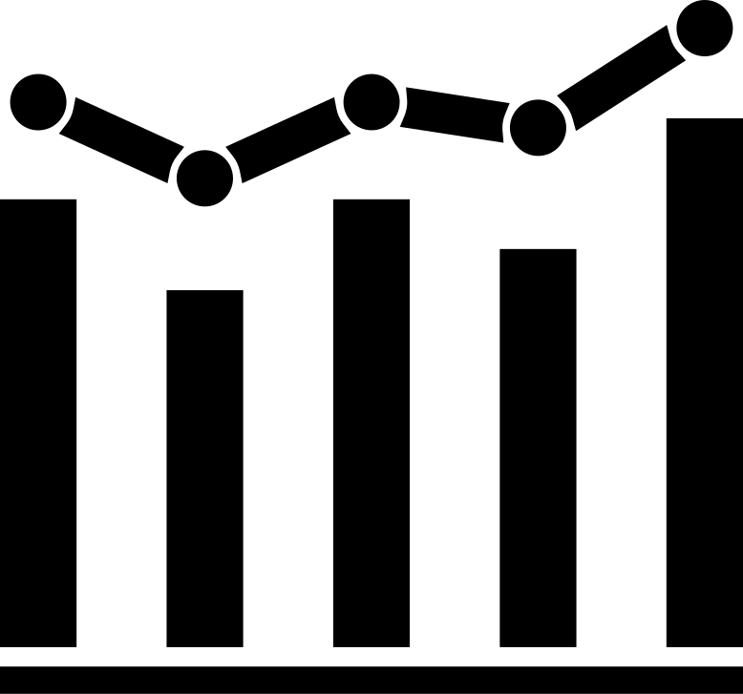




User Behavior
Current Trends in the Digital Broking Sector
Increased Mobile Usage: Users prefer managing their portfolios on mobile apps.
Real-time Updates: Demand for instant market news and price alerts.
Personalization: Users expect tailored recommendations and insights.
Behavioral Insights: Users engage more with notifications that align with their trading habits.
Segment Analysis:
Active Traders:
Needs: Real-time price alerts, breaking news, trade execution updates.
Passive Investors:
Needs: Portfolio performance summaries, quarterly reports, dividend updates.
Beginners:
Needs: Tutorials, webinars, basic market insights, investment tips.
Engagement Patterns
Interaction Frequency: Analyze how often users log in and engage with the app.
Activity Peaks: Identify peak times for user activity

Slide 7
TYPES OF PUSH NOTIFICATIONS
1
Market movements and price alerts
Purpose: To keep users informed about market movements and significant changes that may affect their investments.
Target User Behavior: Users who actively trade and prefer staying updated with real-time information.
Timing : Instant notifications about stock price changes, market trends, breaking financial news, and trading opportunities.
2
Personalized Trade Recommendations
Purpose: To provide users with personalized trading suggestions based on their investment history and preferences.
Target User Behavior: Users who seek advice and recommendations to make informed trading decisions.
Content: AI-driven trade recommendations, tailored insights, and potential investment opportunities.

Slide 8
3
Investment Milestones
Purpose: The primary purpose of investment milestones push notifications is to keep users informed about significant achievements or progress in their investment journey. These notifications are designed to celebrate milestones, encourage continued engagement, and reinforce positive user behavior by acknowledging their accomplishments.
Target User Behavior: Users who regularly invest and track their portfolio performance or those who have specific investment goals such as retirement savings, buying a house, or achieving a certain portfolio value.
Content: The content of investment milestones push notifications should be clear, concise, and encouraging. By effectively implementing investment milestones push notifications, the platform can enhance user engagement, satisfaction, and long-term retention, ultimately driving better investment outcomes for users and increased loyalty to the platform.

Slide 9
4
Community and Social interactions
Purpose: To foster a sense of community among users, encourage social interactions, and enhance user engagement on the platform. These notifications aim to create a more interactive and supportive environment where users can share experiences, provide support, and collaborate with others .
2. Target User Behavior:
Enjoy connecting with others who share similar interests or goals.
Look for peer support, advice, or collaboration opportunities.
3. Content: Updates on trending discussions, new followers, and activities of
followed traders.

Slide 10

IMPLEMENTATION ROADMAP
Development
Integrate AI algorithms for personalization.
Design and test different notification templates.
Integrate the algorithms and push notification service (FCM/OneSignal) in app.
Launch
Roll out notifications to all users.
Monitor performance and make adjustments
MORE USERS
Phase 1
Phase 2
Phase 3
Phase 4
Research and Planning
Testing and Optimization
Conduct user surveys and interviews.
Analyze user data and segment users.
A/B test notification types and timings.
Collect user feedback and refine strategy.

Slide 11
ALGORITHMS TO BE USED
Personalization Algorithms
Recommendation Engines: These algorithms analyze user data (portfolio holdings, watchlists, transaction history) to recommend relevant stocks, news articles, and educational content for personalized notifications. Imagine a system similar to those used by streaming services to suggest movies based on watch history.
Clustering Algorithms: These algorithms group users with similar characteristics (investment styles, risk tolerance) to segment notification delivery. This ensures users receive alerts truly relevant to their interests.
Content & Timing Optimization Algorithms
Natural Language Processing (NLP) Algorithms: NLP can analyze news articles, analyst reports, and social media sentiment to identify relevant information for users. This allows for summarizing this information and including it in push notifications alongside stock alerts, providing actionable insights.
Time Series Forecasting Algorithms: These algorithms analyze historical user data and market trends to predict the optimal times to send notifications for maximum engagement. This ensures users receive price alerts or investment insights when they're most likely to be receptive (e.g., during market hours or based on individual user activity patterns).

Slide 12
ALGORITHMS AND TECH TO BE USED
Engagement & Retention Algorithms:
Next-Event Prediction: Through the analysis of user behavior, such as stock research and time spent on the app, these algorithms have the ability to forecast the user's next investment actions. This enables the timely delivery of notifications recommending pertinent investment opportunities or educational resources to maintain user engagement.
Retention Prediction: The analysis of user behavior can effectively identify those users who are at risk of churning, which refers to discontinuing app usage. Subsequently, the app can deploy targeted notifications containing personalized incentives or educational content to successfully re-engage these users.
Mobile Notification Services (MNS)
Google Cloud Messaging (GCM): Used for Android devices to transmit push notifications from the app server to the user's device.
Apple Push Notification Service (APNS): Used for iOS devices to deliver push notifications.
A/B Testing
A/B testing compares two versions of something (like a push notification) to see which performs better.

Slide 13
METRICS
Metrics | Definition | Importance
Delivery Rate | The percentage of push notifications successfully delivered to users. | Indicates the reliability of the notification delivery system.
Open Rate | The percentage of delivered push notifications that users open. | Reflects user interest and engagement with the notifications.
Click-Through Rate (CTR) | The percentage of opened notifications that result in users clicking on a link or taking a desired action. | Measures the effectiveness of the notification content in driving user actions.
Conversion Rate | The percentage of users who complete a desired action after clicking on a push notification. | Indicates the impact of notifications on achieving business goals
Opt-In Rate | The percentage of app users who agree to receive push notifications. | Indicates how many users are willing to engage with notifications.
Churn Rate | The percentage of users who uninstall the app after receiving push notifications. | Helps identify if notifications are causing user dissatisfaction.

Slide 14
CONCLUSION
After effectively introducing the push notification feature we can expect:
Higher Engagement: Increased user interaction with the app.
Better User Experience: Streamlined investment management.
Improved Retention: Enhanced loyalty through valuable notifications.
In conclusion, the development of a comprehensive push notification strategy for our digital stock broking app marks a significant step towards enhancing user engagement and retention. By leveraging personalized, timely, and actionable notifications, we aim to provide our users with valuable insights, empowering them to make informed investment decisions efficiently.
Blinkx

Slide 15
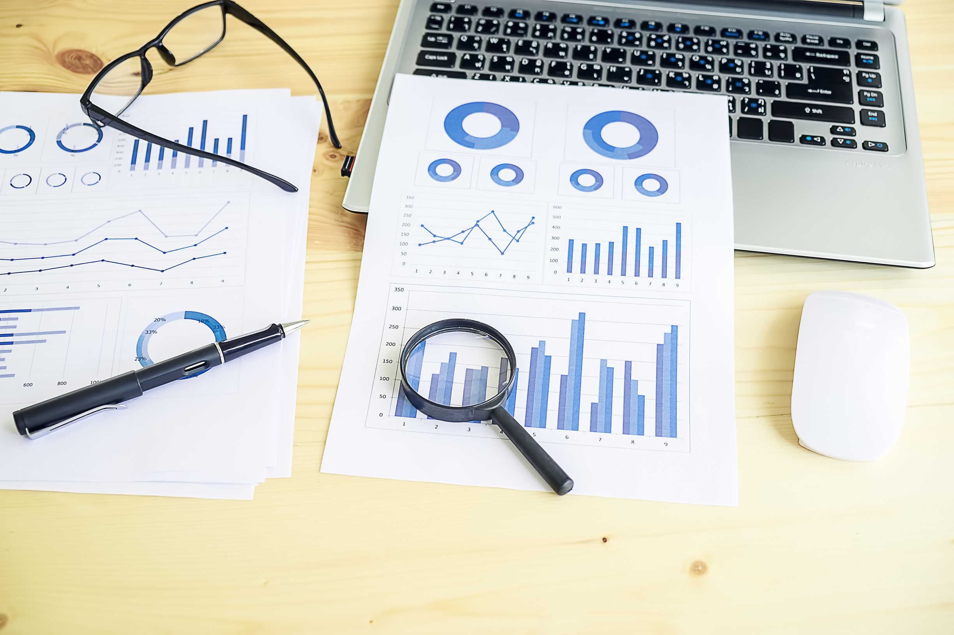
THANK YOU

